Slide 1

Resume
Enhancement
Tool
Team 19
Khushi Shah | Manaswini Nagasamudram | Bindu Bhargavi Palam | Suprita Dwarakanath | Sahiti Etikala

Slide 2
Develop an AI-powered resume optimization tool that helps students tailor their resumes to specific job descriptions. By leveraging Natural Language Processing (NLP) and Machine Learning (ML) techniques, the system will analyze job postings, extract key skills, and compare them with resumes to provide personalized recommendations for improving alignment with employer expectations.
Project Goal

Slide 3


Objectives
•Develop an AI-driven tool to analyze and optimize resumes for better job opportunities.
•Provide tailored suggestions to enhance resume structure, content, and keyword relevance.
•Ensure ATS (Applicant Tracking System) compatibility to improve job application success rates.
•Offer real-time feedback and insights based on industry-specific requirements.

Slide 4
We plan to use:
NLP (Natural Language Processing) to dissect job descriptions and resumes to understand the real meaning behind the words, going beyond simple keyword matching.
ML (Machine Learning): Our recommendation engine learns from successful resumes and job matches to pinpoint skill gaps and suggest improvements.
Data Engineering: We will extract critical features from countless resumes and job postings, building a robust foundation for our AI.
Software Development: We plan to build a user-friendly web tool (or API) that puts the power of AI resume optimization at fingertips.
Area of Work

Slide 5
Dataset Collection:
https://www.kaggle.com/code/gauravduttakiit/resume-screening-using-machine-learning/input
Data Preprocessing:
•Text Cleaning and Normalization: Handle tokenization, punctuation elimination, and text lowercasing.
•Feature Engineering: Create numerical features like term frequency-inverse document frequency (TF-IDF) or word embeddings to represent resumes numerically for model training.
Models to be used: XGBoost, Naive Bayes, KNN, SVM
NLP Techniques: BERT
Background Research

Slide 6
PHASE 2

Slide 7
From Idea to Implementation:
Our Timeline to Build Your Resume Parser
_________________________________________
Ensure API and UI working
Define Requirements
Weeks 5-8
(Phase-2)
Weeks 13-16
(Phase-4)
Weeks 1-4
(Phase -1)
Weeks 9-12
(Phase-3)
Individual Component Development
Bug Fixing, Documentation & Presentation

Slide 8
Explaining the Timeline
Phase 1 – Defining Requirements, finalizing features, datasets and models and
Setting up Git Repository
https://github.com/Sahithi-reddy14/resumeparser
Phase 2 – Task Assignment &
Individual Component Development
Phase 3 - Creating Frontend UI and connecting it to UI &
Integration and Refinement
Phase 4 – Ensure API and UI work Smoothly,
Bug fixing and final Improvements,
Documentation &
Presentation

Slide 9
Task distribution for Phase 2
Step 1: Resume Parsing - Extract text, clean, and preprocess by Manaswini.
Step 2: Visualizations of preprocessed data as plots/diagrams/graphs/tables by Khushi Shah
Step 3: Skill Matching - Implement Tf-Idf or embeddings for comparison by Bindu
Step 4: Start Developing Backend API by Sahiti and Suprita

Slide 10
Resume Parsing & Preprocessing
Parsing Resumes from PDF/DOCX
Used PyPDF2 & docx2txt to extract text from documents
Handled inconsistent formats in resumes
Text Preprocessing
Used spaCy & NLTK for:
Removing stopwords & special characters
Tokenization & Lemmatization
Named Entity Recognition (NER) for Education & Experience
Extracting Key Sections
Classified text into:
Experience (Years, Roles, Companies)
Education (Degrees, Institutions)
Skills (Technical & Soft Skills)

Slide 11
Visualization of Dataset
The Resume Dataset contains structured information about job seekers, including:
Job Categories (e.g., Java Developer, Data Scientist, Testing, etc.)
Skills (e.g., Python, Java, SQL, Machine Learning, etc.)
Education Details (e.g., B.E, MTech, MCA)
Work Experience (if available)
Each resume is classified into a category based on the applicant’s expertise and job domain. By analyzing this data, we can understand which job roles are most common and what skills are in high demand.
Key Visualizations
Job Role Distribution
A bar chart and pie chart display the distribution of job roles, allowing us to see which domains have the highest representation in the dataset.
Skills Analysis
This is crucial for job seekers and recruiters to align their expectations.

Slide 12
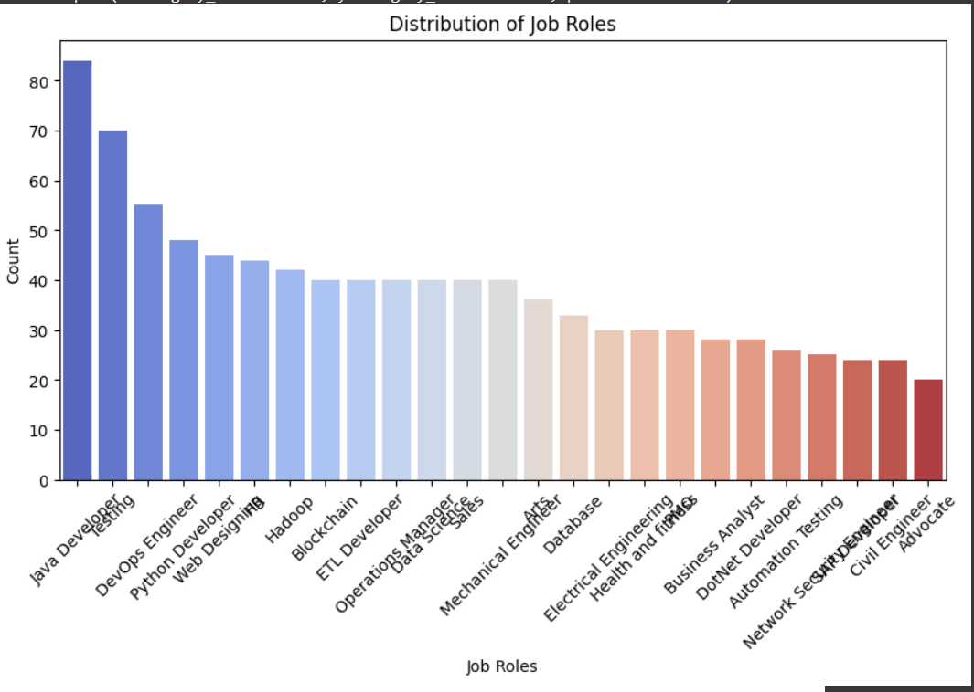
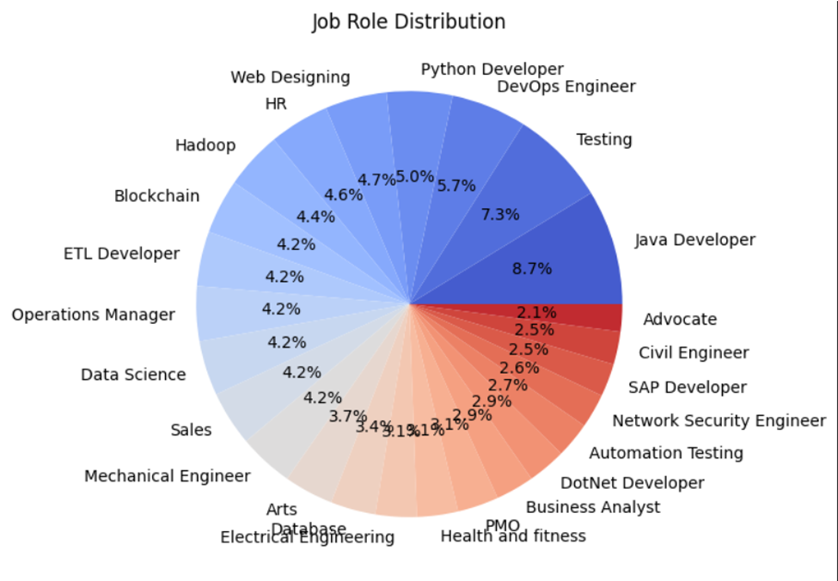
Insights Gained High-Demand Job Roles: Certain categories like "Data Science" and "Software Development" may dominate the dataset. Trending Skills: Programming languages such as Python, Java, and SQL are often the most sought-after. Education Background: Most candidates have engineering or IT-related degrees, but there may be variations based on specialization.
-

Slide 13
Enhancements & Next Steps
What We Improved: - Used BERT embeddings for better semantic understanding of resumes. - Implemented category-specific missing skill detection dynamically. - Compared TF-IDF vs. BERT to analyse effectiveness.
Future Improvements: - Integrate real-time resume parsing with an ATS (Applicant Tracking System). - Use fine-tuned BERT models specific to job recruitment. - Add experience-based weighting (more importance to recent skills).

Slide 14
Backend Implementation
Goal: Develop FastAPI backend for resume parsing.
Responsibilities:
- Build API endpoints for resume upload & processing
- Handle file validation & storage
- Prepare for integration with ML models & TF-IDF

Slide 15
FastAPI Implementation
Why FastAPI?
- Lightweight & High Performance
- Built-in Data Validation with Pydantic
- Easy Integration with ML models & TF-IDF
Implemented Features:
- Resume Upload API (PDF format)
- File Validation & Storage
- Logging & Error Handling

Slide 16
API Endpoints
Implemented Endpoints:
1. GET / → API Health Check
2. POST /upload-resume/ → Upload Resume File
3. POST /match-resume/ → (To be integrated with TF-IDF)
Next Steps:
- Integrate TF-IDF & ML models
- Enhance resume parsing & matching

Slide 17
TF-IDF vs. BERT for Skill Matching
FEATURE | TF-IDF | BERT EMBEDDINGS
Approach | Keyword-based frequency analysis | Context-aware deep learning model
Understanding | Matches exact words | Understands meaning & Context
Accuracy | Limited to word overlap | Captures synonyms & related concepts
Skill Matching | Works well for structured job descriptions | Better for unstructured resumes
Computation | Fast & lightweight | Slightly slower but much more accurate
TF-IDF is simple, fast, and useful for keyword-based matching but fails to understand synonyms.
BERT provides superior matching accuracy by capturing the deeper context of skills.

Slide 18
Algorithm in use: BERT
Why BERT? BERT possesses a profound comprehension of job descriptions and resumes, enabling it to extract key skills, experiences, and qualifications from unstructured text.
Semantic Matching: BERT excels at establishing semantic connections between resumes and job postings, ensuring accurate and insightful recommendations.
Improved Accuracy: Fine-tuning BERT on a resume-job matching dataset enables the model to enhance recommendation accuracy through deep contextual learning.

Slide 19

Challenges
Handling different formats, preserving layouts, and text encoding issues.
Complex Sentence Structure: Resumes can have different writing styles and structures, making it difficult to preprocess text uniformly.
Skills are written in different ways (e.g., “Machine Learning” vs. “ML”), making it hard to count occurrences correctly.
Bert embeddings are powerful but computationally expensive compared to Tf-idf.
Processing large datasets required optimization like batch processing and caching embeddings to reduce runtime.
4. Handling file uploads & validation
5. Ensuring API scalability for large datasets

Slide 20
Solutions to those Challenges
1. Use spaCy’s dependency parsing and part-of-speech tagging to break down complex sentences into more manageable components.
2. Use spaCy and NLKK for lemmatization and stopword removal to reduce the text to its most meaningful form, ensuring better text consistency.
3. Applied string normalization to standardize skill names (e.g., mapping "ML" to "Machine Learning").
4. Used pre-trained models like paraphrase-MiniLM-L12-v2 for a balance of speed & accuracy
5. Using FastAPI’s Background Tasks for large uploads
6. Designing API structure for easy extension.

Slide 21
Blueprint for Phase 3
1. Backend & API Development
Build REST API for integration
Create Flask/FastAPI endpoints
Implement resume & job matching API
Integrate ML model into backend
2. Frontend & UI
- Develop user interface for interaction
- Design form for resume/job input
- Display match score & recommendations
- Connect frontend to API (React.js)
3. Merge components → Connect frontend, backend, and ML model
4. Fine-tune recommendations → Improve skill extraction & match accuracy

Slide 22
PHASE 3

Slide 23
TASKS ACHIEVED IN PHASE 3
Did experiments to choose algorithm.
Implement resume upload and text extraction to allow users to upload resumes and extract text using backend libraries.
Parse job description and extract keywords and skills using spaCy to analyze input job description and identify relevant keywords for matching.
Develop keyword matching and semantic scoring logic to compare resume content with JD keywords and compute a relevance score.
Design Frontend to display results and suggestions to build an interactive UI using Streamlit to show extracted text, scores, and missing keywords.
Test with multiple resume and JD samples to validate accuracy, handle edge cases, and ensure robustness of the pipeline.

Slide 24
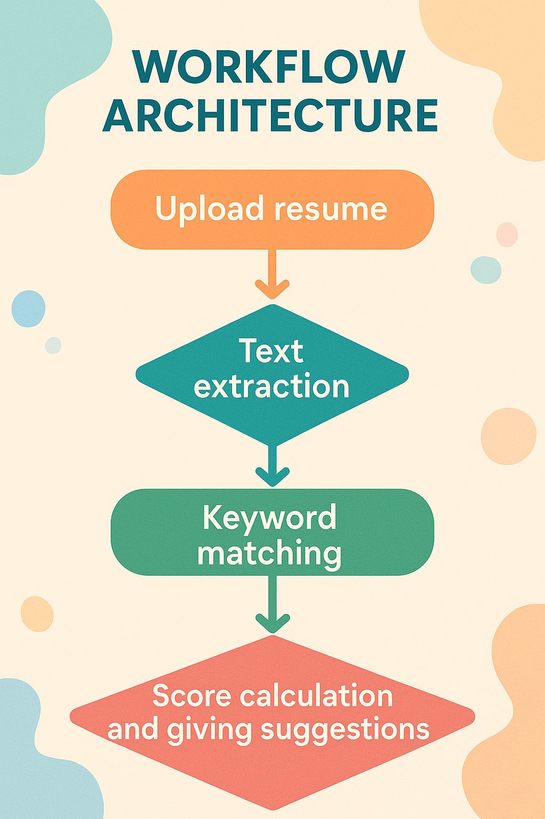
Pipeline of Workflow architecture

Slide 25
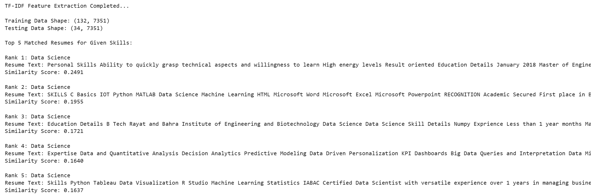
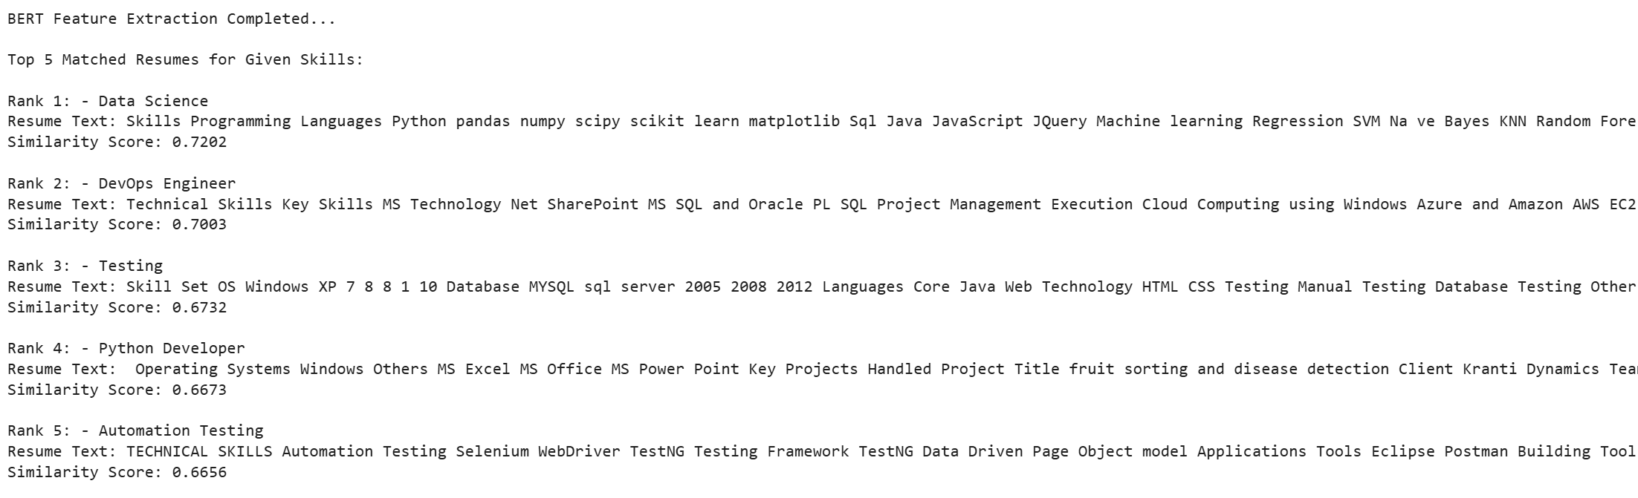
Skill Matching Approach
Skill Matching Using TF-IDF & BERT
Implemented TF-IDF and BERT for resume-skill comparison.
Extracted important words from resumes using TF-IDF (keyword-based matching).
Used BERT embeddings for semantic skill matching, improving accuracy.
Ranked resumes based on similarity scores.
Identified missing skills dynamically for each candidate based on their job category.
Td-idf findings
BERT Model findings

Slide 26
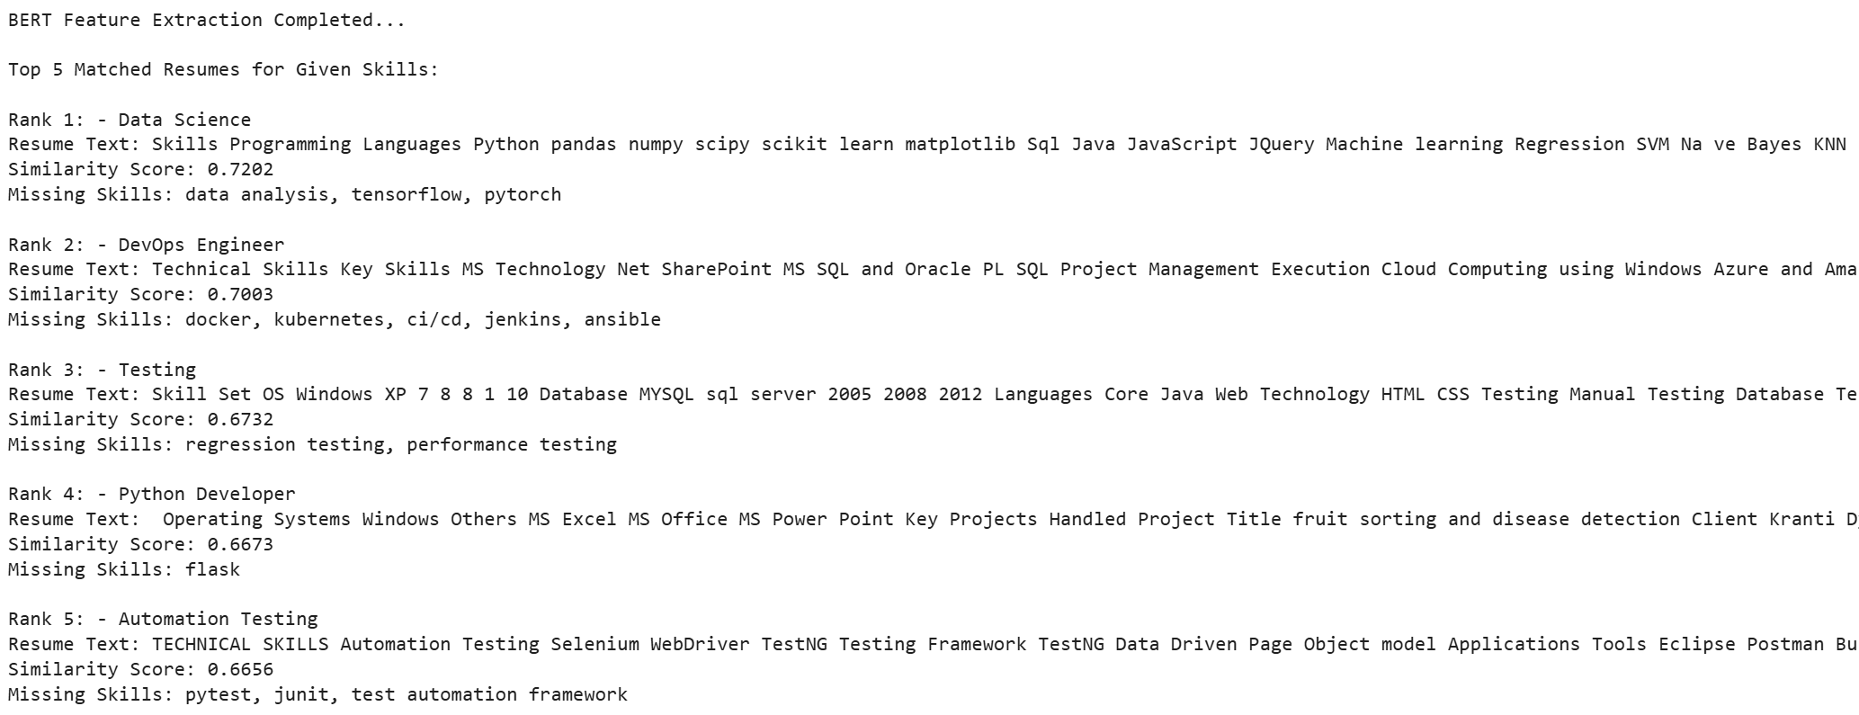
How BERT Works in Our Project
Convert resumes & job skills into numerical embeddings (vector representation).
Compute similarity scores between job descriptions and resumes.
Rank resumes based on relevance to required skills.
Missing Skill Detection Using AI
Each job category has a predefined skill set (e.g., Data Science → Python, ML, SQL).
BERT scans the resume and identifies missing skills from the required set.
Helps candidates improve their skills for better job fit.

Slide 27
Experimentation with Algorithms
TF-IDF + Logistic Regression
Compared SVM, Naive Bayes, XGBoost
BERT embeddings
Selected BERT for its superior context handling

Slide 28
Skill Matching Results
Resume and job description pairs were scored for skill similarity using both TF-IDF and BERT.
On average, the BERT-based model achieved approximately 87% accuracy in relevant skill detection.
Each resume received feedback including matched skills, missing skills, and suggestions for improvement.
Results demonstrated high alignment with expected domain-specific skills.

Slide 29
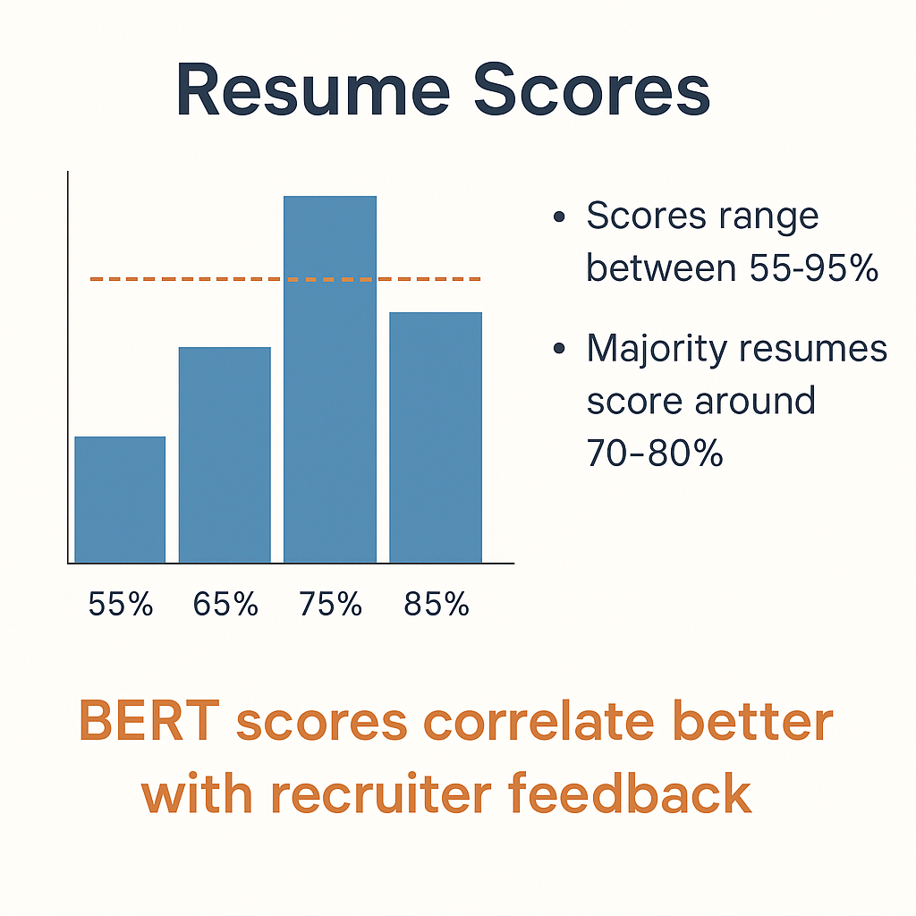
Semantic Scores
Scores range between 55-95%
Majority resumes score around 70-80%
BERT scores correlate better with
recruiter feedback
BERT scores
Resume scores

Slide 30
Challenges in Phase III
Integrating frontend and backend introduced timing and state synchronization issues.
Handling diverse resume formats, especially scanned or improperly structured PDFs, proved complex.
BERT embeddings consumed significant memory and processing power, affecting scalability.
Maintaining accuracy while optimizing speed became a recurring challenge.

Slide 31
Solutions Implemented
FastAPI Background Tasks allowed for non-blocking processing of large resume files.
Repeated computations of embeddings were avoided using caching mechanisms.
Skill normalization techniques were applied to map acronyms and synonyms to standard terms.
Code modularization and route separation improved maintainability and debugging.

Slide 32
Future Scope
1. Displaying errors clearly when ML model crashes or fails
2. Turn it into a full platform where users:
- Upload an existing resume OR build one from scratch
- Get real-time suggestions based on a specific job description
- See a score breakdown: ATS match %, missing sections, grammar, tone
3. Mobile App Integration: Build a mobile version (React Native or Flutter frontend) so users can upload resumes or job descriptions on-the-go.
4. Intelligent Scoring System: Train a model that learns to score resumes based on Language quality and relevant keywords.

Slide 33
Future Scope
5. Personalized Recommendations: Based on the user's resume and job type, suggest Certifications to pursue, Skills to learn and Ideal resume formats/styles.
6. Resume Summarization with NLP: Use NLP to generate a 1-line summary or objective for the resume automatically.
7. Integration with Job Portals & APIs: Integrate with LinkedIn Jobs, Indeed, or Glassdoor APIs to fetch job descriptions directly and allow users to apply directly after optimizing.
8. Career Coach Companion: add a chatbot feature using GPT-based models to simulate HR interview questions based on resume and give behavioral tips and strengths/weakness analysis

Slide 34
Task list before Final Phase
1. Highlight Resume Gaps
Color-code missing keywords
Suggest action items like “Add experience with XYZ tool”
2. Run Usability Testing
Try with different resumes & JDs
Ensure UI doesn’t break on invalid inputs
Fix responsiveness & bugs
3. Prepare for GitHub Upload & Submission
Clean code & remove unnecessary files
Update README.md with instructions, screenshots
Push essential project files

Slide 35
Thank you

